Slide 1
Online Role-based training resources: Microsoft Learn https://docs.microsoft.com/en-us/learn/

Slide 2
Module 12: Row-level Security

Slide 3
Learning Objectives
You will learn the following concepts:
Security
Row-level security
Static method
Dynamic method
Notes:
By the end of this module, you’ll be able to:
Implement row-level security using both the Static and Dynamic methods.

Slide 4
Lesson 1: Security in Power BI

Slide 5
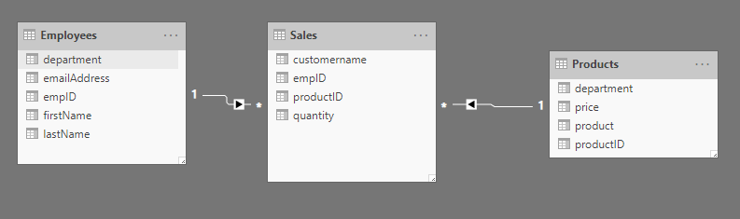
Security overview in Power BI
Secure reports and workspace by sharing them to Active Directory users and groups.
Notes:
In Power BI, you can secure reports and workspaces by sharing them to active directory users and groups. It is also possible to share a single report, but have users see different data, according to their job role.
<NOTE: use the image in this slide to explain the following:>
For example, You would like to make one report where employees in a specific department can only see the sales for that department. For instance, Maria Cameron works in the Game department and should only see the sales from that department. She should not see the sales from Sports, Clothing, or Automotive.
There are two ways to implement row-level security in Power BI: the static method and the dynamic method.
Row-level security (RLS) uses a DAX filter as the core logic mechanism. This module will demonstrate how you can implement row-level security in Power BI using DAX to ensure that only the appropriate person is seeing the appropriate records.

Slide 6
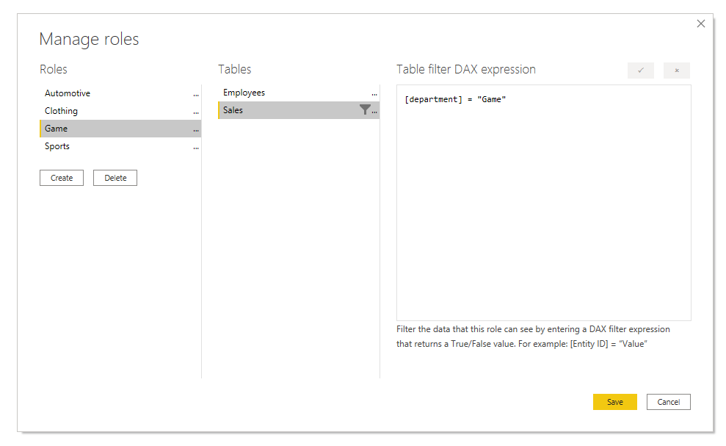
Static Method
Uses a fixed value in the DAX filter.
Notes:
The static method in Row-level security (RLS) uses a fixed value in the DAX filter, while the dynamic method uses a DAX function.
Power BI Row-level security (RLS) uses DAX to control who can see which data. Think of it as always adding another filter to the appropriate users, no matter what filters, slicers, or interactions they choose on a Power BI Report. Each time a member of that role interacts with the report, Power BI will add that filter to their interactions, thus limiting them what they see. Notice how you use a fixed value in the filter on the right-side of the equal sign, in this case, "Game". This means that if you ever need to add a category, you would need to create a new role with a new value in the DAX expression.
There are several steps to configure static RLS:
Create a report: First, we follow the typical steps to create a report in Power BI Desktop. Confirm that the relationship exists between the two tables using the modeling tab. It should be a 1 to many relationship on the empID column.
Create the RLS role using DAX: Power BI Row-level security (RLS) uses DAX to control who can see which data. Think of it as always adding another filter to the appropriate users, no matter what filters, slicers, or interactions they choose on a Power BI Report.
Test the role: Validate that this is working by selecting the Modeling tab, and select View as Roles.
Deploy the report: Deploy the report to the Power BI service by selected the Publish button on the Home tab. Choose a workspace.
Add members to the role: Navigate to your workspace in the Power BI Service. The Row-Level Security screen appears. From here, you can add active directory users and security groups to the security role. When members are added to this role, they will have the DAX filter that you previously defined applied to them.
Test the roles: You can also test this inside the Power BI Service. If you select the ellipsis next to the Game role on this screen, you can see Test as role.

Slide 7
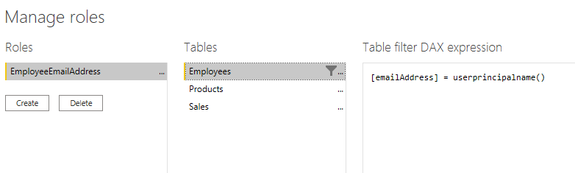
Dynamic Method
Uses a dynamic value in the DAX filter.
Notes:
There's a way to set up row-level security only once, without the need to continue to maintain it dynamically.
Instead of the fixed string we used before like "Game" or "Clothing", we're using a DAX function in the row-level security filter. This function, userprincipalname(), will compare the email address from the Employees table with the email that the user uses to log into the Power BI service.
If he uses the email address russel@tailwindtraders.com to sign in to the Power BI service, it will compare that value to the email address in the Employees table. Assuming there's a relationship created between Employees and Sales, the user will only see the data he or she created.

Slide 8
Review Questions
1
Q – Which function will tell you the logged on username in the Power BI Service?
A – USERPRINCIPALNAME()
2
Q – Where can you test RLS by using different security roles?
A – Both Power BI Desktop and Power BI Service.

Slide 9
Module Overview
We covered the following concepts:
Security
Row-level security
Static method
Dynamic method
Notes:
In this module we discussed:
How to implement row-level security using both the Static and Dynamic methods.

Slide 10
Lab: Enforce Row-Level Security
Lab: Enforce Row-Level Security

Slide 11

References
PL-300 Implement row-level security
https://docs.microsoft.com/en-us/learn/modules/row-level-security-power-bi/
Notes:
It is good practice to tie back your ILT deliveries to role-based learning materials on Microsoft Learn. What is listed here should supplement your delivery and the role-based training your course is affiliated with. It is important to give the learners continued education opportunities for growth.
Steps:
Insert the page title here along with the url to other Microsoft resources
It is only necessary to duplicate this slide if there are more than 6 references that need to be shared with the students.

Slide 12
Closing slide

